Slide 1
EDGE DECTION , FEATURE EXTRACTION AND SEGMENTATION

Slide 2
EDGE DETECTION
Edge detection is a fundamental technique in image processing used to identify boundaries within an image. It's crucial for tasks like object detection, image segmentation, and feature extraction. Essentially, edge detection algorithms aim to locate points where the intensity of an image changes abruptly, which typically signifies the presence of an edge or boundary between different objects or regions.
When the Sobel kernel is applied to a region of the image, it performs a convolution operation that emphasizes regions with high spatial frequency, which correspond to edges. For example, applying the Gx kernel will highlight vertical edges, while Gy will highlight horizontal edges.

Slide 3
Sobel Operator
The Sobel operator is a discrete differentiation operator that computes an approximation of the gradient of the image intensity function. It emphasizes edge detection in both horizontal and vertical directions by combining Gaussian smoothing and differentiation, making it less sensitive to noise.

Slide 4
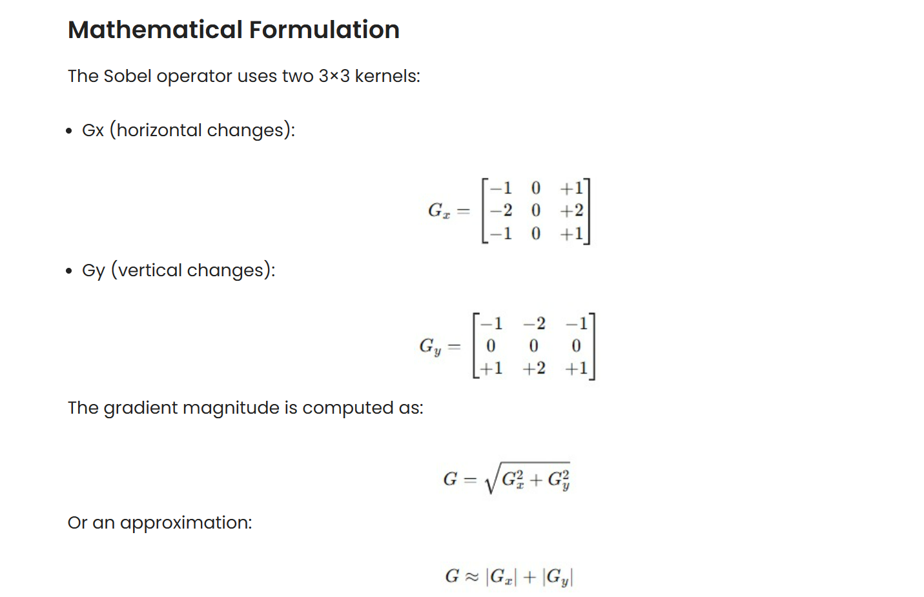

Slide 5
Laplacian Operator
The Laplacian operator is a second-order derivative operator that highlights regions of rapid intensity change, effective in edge detection. Unlike Sobel, which is directional, the Laplacian is non-directional and detects edges in all directions.
The Laplacian operator, often denoted as Δ or ∇², is a differential operator used in mathematics and physics to calculate the second spatial derivative of a scalar function. It essentially measures the rate of change of the rate of change of a function across its spatial domain. In simpler terms, it indicates how much the function’s value deviates from the average value of its surrounding points.

Slide 6
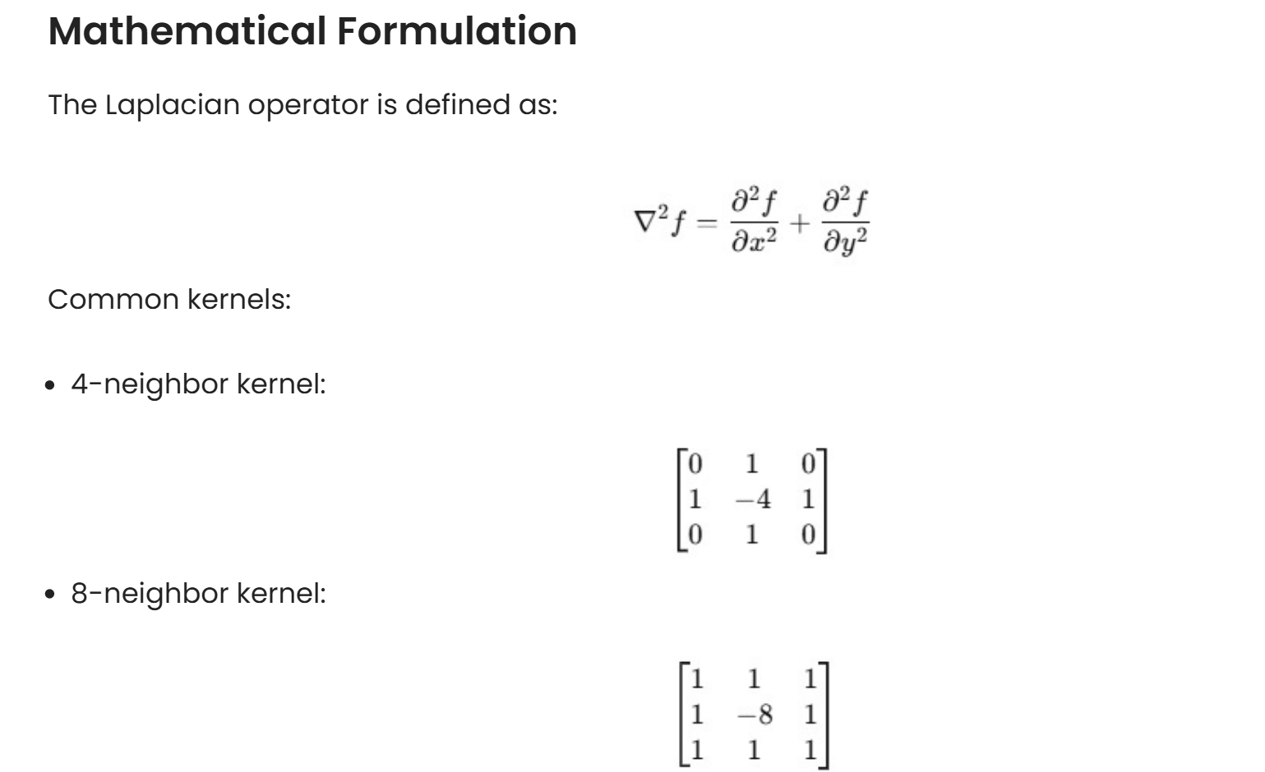

Slide 7
Canny Edge Detector
The Canny edge detector was developed by John Canny in 1986 and is still one of the most reliable edge detection algorithms. It combines gradient-based edge detection with advanced logic to ensure that the detected edges are thin, connected, and free from noise. Canny Edge Detection is one of the most popular edge-detection methods in use today because it is so robust and flexible. The algorithm itself follows a three-stage process for extracting edges from an image. Add to it image blurring, a necessary preprocessing step to reduce noise. This makes it a four-stage process, which includes:
Noise Reduction
Calculating the Intensity Gradient of the Image
Suppression of False Edges
Hysteresis Thresholding

Slide 8
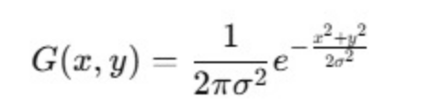
Noise Reduction
Raw image pixels can often lead to noisy edges, so it is essential to reduce noise before computing edges In Canny Edge Detection, a Gaussian blur filter is used to essentially remove or minimize unnecessary detail that could lead to undesirable edges. Have a look at the image below; Gaussian blur has been applied to the image. As you can see, it appears slightly blurred but still retains a significant amount of detail from which edges can be computed.

Slide 9
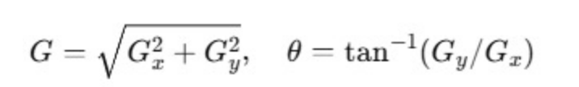
Calculating the Intensity Gradient of the Image
Once the image has been smoothed (blurred), it is filtered with a Sobel kernel, both horizontally and vertically. The results from these filtering operations are then used to calculate both the intensity gradient magnitude, and the direction for each pixel. The gradient direction is then rounded to the nearest 45-degree angle.

Slide 10
Suppression of False Edges
After reducing noise and calculating the intensity gradient, the algorithm in this step uses a technique called non-maximum suppression of edges to filter out unwanted pixels (which may not actually constitute an edge). To accomplish this, each pixel is compared to its neighboring pixels in the positive and negative gradient direction. If the gradient magnitude of the current pixel is greater than its neighboring pixels, it is left unchanged. Otherwise, the magnitude of the current pixel is set to zero. The following image illustrates an example. As you can see, numerous ‘edges’ associated with the image have been significantly subdued.

Slide 11
Hysteresis Thresholding
If the gradient magnitude value is higher than the larger threshold value, those pixels are associated with solid edges and are included in the final edge map.
If the gradient magnitude values are lower than the smaller threshold value, the pixels are suppressed and excluded from the final edge map.
All the other pixels, whose gradient magnitudes fall between these two thresholds, are marked as ‘weak’ edges (i.e. they become candidates for being included in the final edge map).
If the ‘weak’ pixels are connected to those associated with solid edges, they are also included in the final edge map.

Slide 12
What is Feature Extraction?
Feature extraction is the process of transforming raw data into a simplified and informative set of features or attributes. This reduces data complexity and highlights the most relevant information making it easier for machine learning models to analyze and learn from the data efficiently. It plays an important role in improving model accuracy and reducing computational costs by focusing on essential aspects of the data.

Slide 13
Importance of Feature Extraction
Reduced Computation Cost: Raw data, especially from images or large datasets can be very complex. Feature extraction makes this data simpler hence reducing the computational resources needed for processing.
Improved Model Performance: By focusing on key features, machine learning models can work with more relevant information leading to better performance and more accurate results.
Better Insights: Reducing the number of features helps algorithms concentrate on the most important data, eliminating noise and irrelevant information which can lead to deeper insights.
Prevention of Overfitting: Models with too many features may become too specific to the training data, making them perform poorly on new data. Feature extraction reduces this risk by simplifying the model.

Slide 14
Bag of words (BoW) model in NLP
In Natural Language Processing (NLP) text data needs to be converted into numbers so that machine learning algorithms can understand it. One common method to do this is Bag of Words (BoW) model. It turns text like sentence, paragraph or document into a collection of words and counts how often each word appears but ignoring the order of the words. It does not consider the order of the words or their grammar but focuses on counting how often each word appears in the text.
This makes it useful for tasks like text classification, sentiment analysis and clustering

Slide 15
Preprocessing the Text
Before applying the BoW model, we need to preprocess the text. This includes:
Converting the text to lowercase
Removing non-word characters
Removing extra spaces

Slide 16
Counting Word Frequencies
In this step, we count the frequency of each word in the preprocessed text. We will store these counts in a pandas DataFrame to view them easily in a tabular format.
We initialize a dictionary to hold our word counts.
Then, we tokenize each sentence into words.
For each word, we check if it exists in our dictionary. If it does, we increment its count. If it doesn’t, we add it to the dictionary with a count of 1.

Slide 17
Selecting the Most Frequent Words
Now that we have counted the word frequencies, we will select the top N most frequent words (e.g top 10) to be used in the BoW model. We can visualize these frequent words using a bar chart to understand the distribution of words in our dataset.

Slide 18
Building the Bag of Words (BoW) Model
Now we will build the Bag of Words (BoW) model. This model is represented as a binary matrix where each row corresponds to a sentence and each column represents one of the top N frequent words. A 1 in the matrix shows that the word is present in the sentence and a 0 shows its absence.
We will use a heatmap to visualize this binary matrix where green shows the presence of a word (1) and red shows its absence (0).

Slide 19
Visualizing Word Frequencies with a Word Cloud
Finally, we can create a Word Cloud to visually represent the word frequencies. In a word cloud, the size of each word is proportional to its frequency which makes it easy to identify the most common words at a glance.

Slide 20
HOG Feature Visualization in Python Using skimage
Object detection is a fundamental task in computer vision, where the goal is to identify and locate objects within images or videos. However, this task can be challenging due to the complexity of real-world images, which often contain varying lighting conditions, occlusions, and cluttered backgrounds. Traditional approaches to object detection rely on handcrafted features, which can be time-consuming and may not generalize well to new scenarios. One popular method for feature extraction is the Histogram of Oriented Gradients (HOG) technique.

Slide 21
Understanding HOG Features
HOG features were first introduced by Dalal and Triggs in 2005 as a robust feature extraction method for pedestrian detection. The core idea behind HOG is to capture the distribution of gradient orientations in an image, which can be used to describe the shape and appearance of objects. HOG features are computed by dividing an image into small cells, calculating the gradient orientations within each cell, and then aggregating these orientations into a histogram. This histogram represents the distribution of gradient orientations, which can be used as a feature vector for object detection.

Slide 22
Advantages of HOG Feature
HOG features have several benefits that make them an attractive choice for object detection:
Robustness to lighting changes: HOG features are invariant to changes in lighting conditions, making them suitable for object detection in real-world scenarios.
Robustness to occlusions: HOG features can handle partial occlusions, allowing for accurate object detection even when objects are partially hidden.
Computational efficiency: HOG features can be computed efficiently, making them suitable for real-time object detection applications.
Flexibility: HOG features can be used with various classification algorithms, such as Support Vector Machines (SVMs) and Random Forests, to name a few.

Slide 23
Visualizing HOG Features with Python and skimage
To understand how we can implement and visualize Histogram of Oriented Gradients (HOG) features using Python's skimage library. Let's start by importing necessary modules: color conversion utilities from skimage, HOG feature extraction, image data, exposure utilities, input-output functions, and plotting functionalities from matplotlib.
An example image of an astronaut is loaded using data.astronaut(). The image is converted to grayscale using color.rgb2gray(). converting the image to grayscale simplifies the feature extraction process and improves the performance and interpretability of the HOG algorithm for tasks such as object detection and recognition.
Next, HOG features are extracted from the grayscale image using the hog() function, specifying parameters like orientations, pixels per cell, and cells per block. The visualize=True argument ensures the computation of the HOG image.

Slide 24
Customizing HOG Feature Visualization with skimage
Following the same procedure, in this example we will compute HOG features for the coffee image, which is another built-in image in skimage using hog function from skimage. Following are the improvements made:
Added a title to the figure for better context.
Added annotations to the subplots for clarity.
Used multichannel=True to ensure compatibility with color images.
Removed the unnecessary channel axis specification.
Improved layout and spacing for better aesthetics.
HOG features offer a powerful tool for object detection, providing a robust and efficient way to represent images. By visualizing HOG features using Python and skimage, we can gain a deeper understanding of how these features capture the essence of an image, enabling accurate object detection in various scenarios. Whether you're working on pedestrian detection, facial recognition, or object tracking, HOG features are an essential component of any computer vision pipeline.

Slide 25
Introduction to Convolution Neural Network
Convolutional Neural Networks (CNNs), also known as ConvNets, are neural network architectures inspired by the human visual system and are widely used in computer vision tasks. They are designed to process structured grid-like data, especially images by capturing spatial relationships between pixels.
Automatically learn hierarchical features through convolution operations, from simple edges and textures to complex shapes and objects.
Detect objects at different positions within an image, ensuring robustness to spatial variations.
Reduce computational complexity by processing local regions instead of the entire image at once.

Slide 26
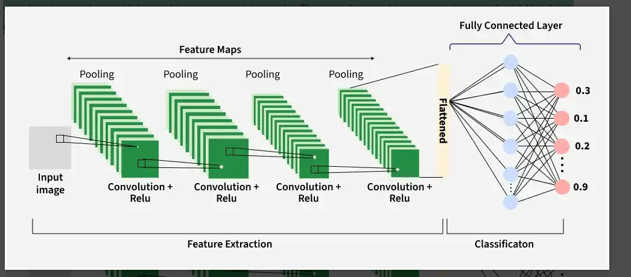

Slide 27
Key Components of CNN
A complete Convolution Neural Networks architecture is also known as covnets. A covnets is a sequence of layers and every layer transforms one volume to another through a differentiable function.
Let’s take an example by running a covnets on of image of dimension 32 x 32 x 3.

Slide 28
Input Layer
The input layer receives the raw image data and passes it to the network for processing. In CNNs, input is typically a 3D volume (width × height × depth).
Stores pixel values of the image (e.g., 32 × 32 × 3 for RGB images).
Preserves the spatial structure of the image for further feature extraction.

Slide 29
Convolutional Layer
The Convolutional Layer is responsible for extracting important features from the input data. It applies a set of learnable filters (kernels) that slide over the image and compute the dot product between the filter weights and corresponding image patches, producing feature maps.
Uses small filters (e.g., 2×2, 3×3, 5×5) to scan the input image.
Generates feature maps that capture patterns such as edges, textures and shapes.

Slide 30
Example: Using 12 filters results in an output volume of 32 × 32 × 12.
The Convolutional Layer is responsible for extracting important features from the input data. It applies a set of learnable filters (kernels) that slide over the image and compute the dot product between the filter weights and corresponding image patches, producing feature maps.
Uses small filters (e.g., 2×2, 3×3, 5×5) to scan the input image.
Generates feature maps that capture patterns such as edges, textures and shapes.
Example: Using 12 filters results in an output volume of 32 × 32 × 12.

Slide 31
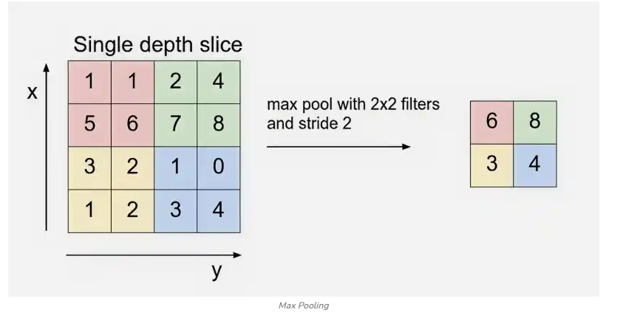

Slide 32
Flattening
Flattening converts the multi-dimensional feature maps into a one-dimensional vector after convolution and pooling. This vector is then passed to the fully connected layer for classification or regression.
Example: Flattening 16 × 16 × 12 results in a vector of size 3072 (16 × 16 × 12).

Slide 33
Fully Connected Layer
The fully connected (dense) layer performs high-level reasoning using extracted features and produces the final classification scores.
Example: The 3072-length vector is connected to neurons for classification

Slide 34
Output Layer
The output layer converts final scores into probabilities using activation functions like Sigmoid (binary classification) or Softmax (multi-class classification).
Example: For 10 classes, Softmax produces 10 probability values each representing the likelihood of a class.

Slide 35
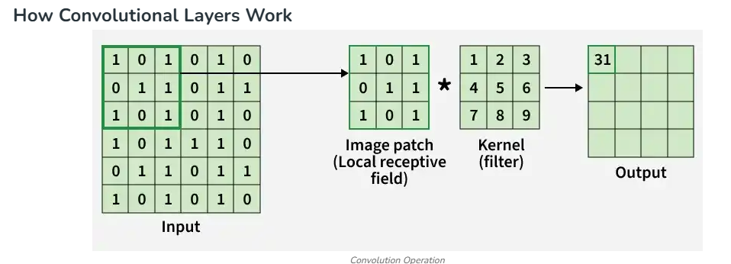

Slide 36
Image Segmentation with Watershed Algorithm-OpenCV Python
Image segmentation is a fundamental computer vision task that involves partitioning an image into meaningful and semantically homogeneous regions. The goal is to simplify the representation of an image or make it more meaningful for further analysis. These segments typically correspond to objects or regions of interest within the image.

Slide 37
Watershed Algorithm
The Watershed Algorithm is a classical image segmentation technique that is based on the concept of watershed transformation.The segmentation process will take the similarity with adjacent pixels of the image as an important reference to connect pixels with similar spatial positions and gray values.
When do I use the watershed algorithm?
The Watershed Algorithm is used when segmenting images with touching or overlapping objects. It excels in scenarios with irregular object shapes, gradient-based segmentation requirements, and when marker-guided segmentation is feasible.

Slide 38
Working of Watershed Algorithm
The watershed algorithm divides an image into segments using topographic information. It treats the image as a topographic surface, identifying catchment basins based on pixel intensity. Local minima are marked as starting points, and flooding with colors fills catchment basins until object boundaries are reached. The resulting segmentation assigns unique colors to regions, aiding object recognition and image analysis.
The whole process of the watershed algorithm can be summarized in the following steps:

Slide 39
Marker placement: The first step is to place markers on the local minima, or the lowest points, in the image. These markers serve as the starting points for the flooding process.
Flooding: The algorithm then floods the image with different colors, starting from the markers. As the color spreads, it fills up the catchment basins until it reaches the boundaries of the objects or regions in the image.
Catchment basin formation: As the color spreads, the catchment basins are gradually filled, creating a segmentation of the image. The resulting segments or regions are assigned unique colors, which can then be used to identify different objects or features in the image.
Boundary identification: The watershed algorithm uses the boundaries between the different colored regions to identify the objects or regions in the image. The resulting segmentation can be used for object recognition, image analysis, and feature extraction tasks.

Slide 40
Implementing the watershed algorithm using OpenCV
OpenCV (Open Source Computer Vision Library) is an open-source computer vision and machine learning software library. OpenCV contains hundreds of computer vision algorithms, including object detection, face recognition, image processing, and machine learning.
Here are the implementation steps for the watershed Algorithm using OpenCV:

